Slide 1

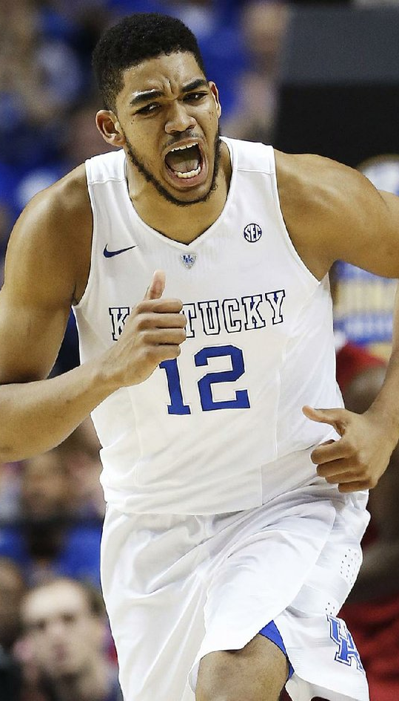

Predicting NBA Success
John Ajit, Nate Dorsey, Ben Kim

Slide 2

Context
We took our data from the draft years 2014-2018
Only 1.2% of NCAA players make it to the NBA
Roughly 450 NBA players, 24 All-Stars

Slide 3
Description of Code
Input
Player college stats
Apply inputs to formula
Output
Visual of predicted success in NBA
Formula

Slide 4

Formula
1.35×PTS+0.6×REB+0.9×AST+0.45×STL+0.3×BLK−0.5×((10)1 - Missed FG) −0.35×10(1-Missed FT)−0.25×TO
Notes:
Don't say its just offense, its overall player efficiency,
SAY ONLY IF NECCESARY
There is also a formula that is similar to this whole idea, called PER or Player Efficiency Rating which takes even more stats from this but unfortunately uses data that we don't have access to. Some of the additional stats that it has includes, value of possession,

Slide 5
Explain what and why
Making this equation, we assigned specific weightings to a player's stats based on how a player is evaluated in terms of success for their production.
Each coefficient represents a specific weighting
Example: A weighting of 1.35 is assigned to points because this is possibly the highest weighting assigned to a player's production whether that be in college or professionally.

Slide 6
Axes
X-Axis, PPR or Player Performance Rating: our formula based on individual stats
Y-Axis, Win Share: rating based on team success, team stats, individual stats, wins
Notes:
Win Share is based on much more than individual stats, win share includes team stats, wins, league wide stats, and how long you spend at a certain college or team, stat made by basketball statisticians that is used to see how much a certain player legitimately contributes to their respective team, win share also includes a combination of offense and defense

Slide 7
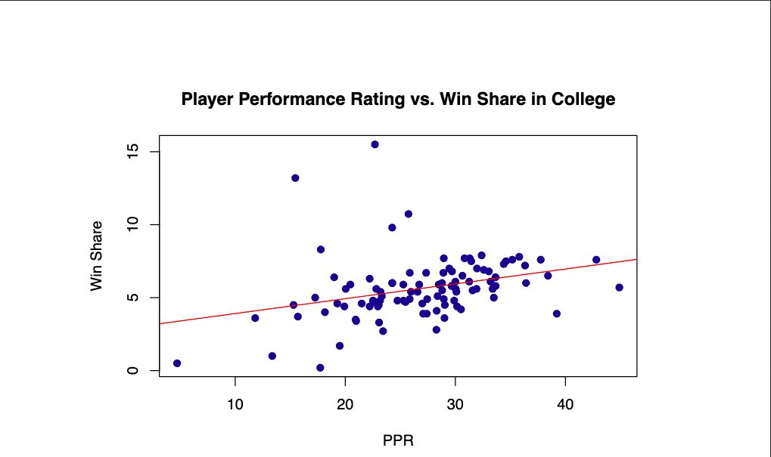
Collegiate Player Performance Rating vs. Win Share

Slide 8
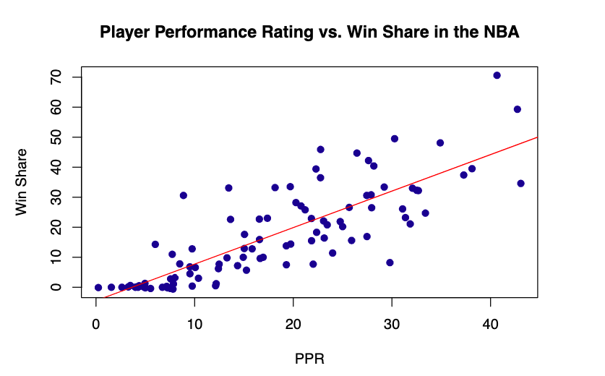
NBA Player Performance Rating vs. Win Share
Notes:
Explain how we got the numbers for the y lines
How an All-Star caliber player is defined
How a Regular Player is Defined

Slide 9
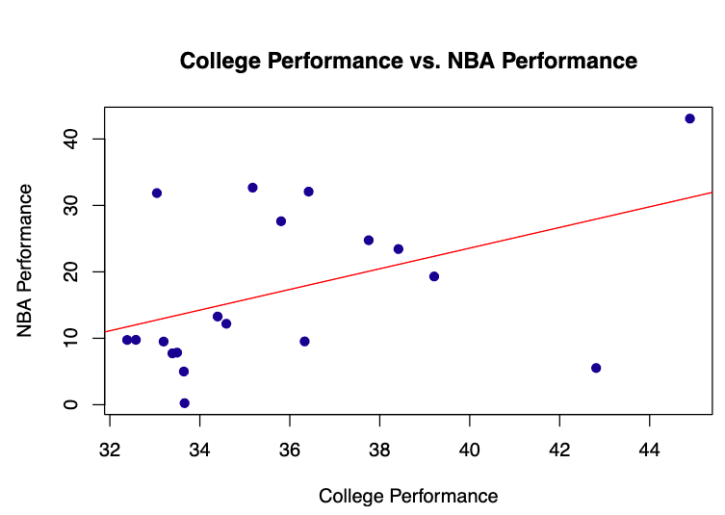
Case Studies - Comparing Collegiate Performance Ratings to the NBA

Slide 10
Analysis
PPR and Win Share
WS Mean(c): 5.623
WS Mean(n): 17.34
WS Min & max (c): (.2, 15.5)
WS Min & max (n):( -.6, 70.6)
PPR(c): condensed between 20 and 40
PPR(n): less condensed and moved to left of diagram

